Slide 1
Notes about neutrino

Slide 2
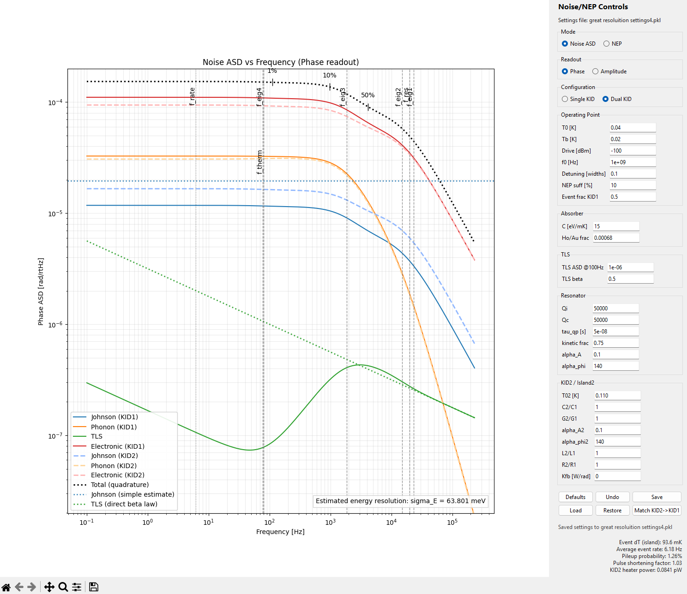
Good setings

Slide 3
Copied over alpha calc
Indicates lower alpha for lower TC
Need TC >3 K for alpha of 100
Codex say dfrdt is ~ 1ppm level at low temps, with Qi are >1r6 do
So alpha - -2Qi T/ fr dfr dT = -2(1e6)(.05K)( *1e-5/K)

Slide 4
Looks like alpha ~150 for 3 K device at 4
40 mk, 5% of Tc
Tc=3k would have higher sensitivity due Mattis Bardeen, alpha =140
Tc=2k -> alpha =100

